Slide 1
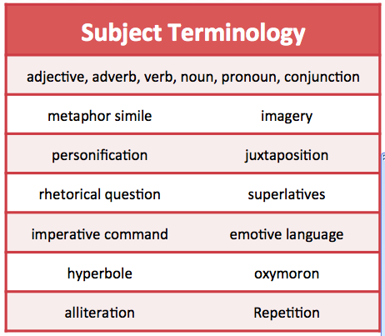
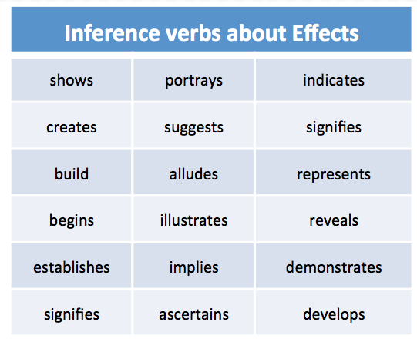
AO2 The Language Questions Paper 1, Q2, 8 marks, 2 paras 10 mins Paper 2, Q3, 12 marks, 3 paras 15 mins
Typical Question: How does the writer use language to show…
Phrases The writer’s use of … …are used to show… …has the effect of… …causes the reader to…
Grade 1-3 Get The Basics | Grade 4-5 Hitting the Middle | Grade 6+ Going for the Top
Point + Evidence + General Effects The writer uses the word “shaking” to show how the wind is so strong and moves the coach. | Subject Terminology + Embedded Evidence + Effects The writer uses the verb “shaking” to emphasize the force of the wind and highlight to the reader how unpredictable and strong it was. | Subject Terminology + Embedded Evidence + Specific Effects The writer demonstrates the power of the storm through the use the verbs “shaking, pummeling, bombarding” highlighting to the reader how unpredictable and strong the storm is. It conveys a darker more sinister side to the storm through personification as it “cloaked them in mist.”
Sentence Frame : The writer uses _______________ “_____________” __________________
Subject terminology Evidence Effects

Slide 2
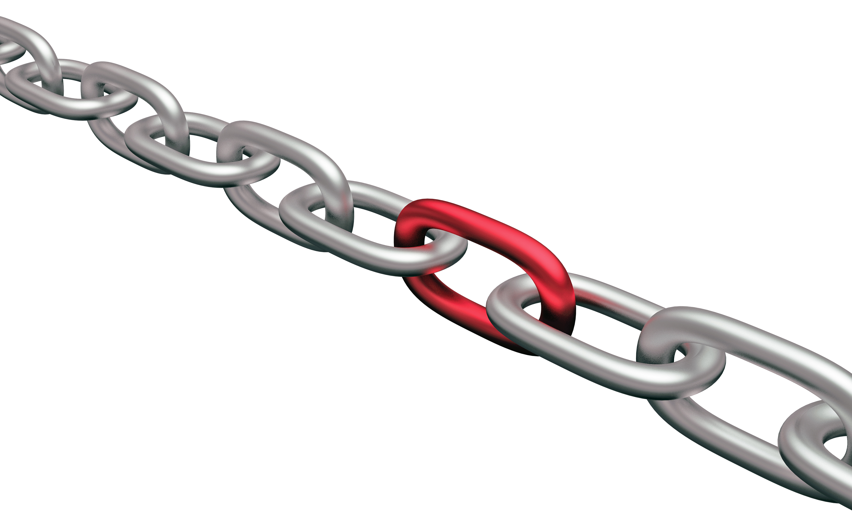
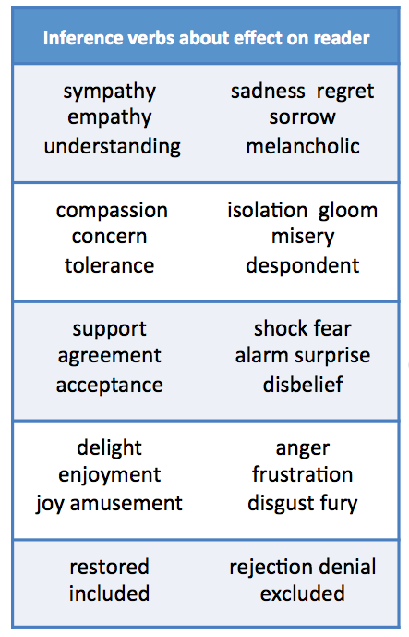
AO2 The Structure Question Paper 1 Q3 8 marks 3 bullet points, 3 mini paras , spend 15 mins
Typical Question: How does the writer structure the text to show…
Phrases The extract begins with… At the beginning… …perspective shifts… The focus of the text changes… The tone changes to show… The order of events shows… The key phrase is repeated… The use of dialogue reflects… Here we learn that… The ending reminds the reader of… In the final paragraph… | Subject Terminology S Semantic field T Tone, Tension R Repetition U strUcture of sentence C Change of focus T Time U pUnctuation R foReshadowing E Ending & beginnings D Dialogue | Phrases for Specific Effects
Grade 1-3 Get The Basics | Grade 4-5 Hitting the Middle | Grade 6+ Going for the Top
Point + Evidence + General Effects At the beginning the writer focuses on the weather saying “the wind came in gusts”. This makes the reader think that something bad is going to happen next. | Subject Terminology + Embedded Evidence + Effects At the beginning the writer focuses on the weather to foreshadow danger as “the wind came in gusts”, which indicates to the reader that the storm represents danger or a hazard for the character. | Subject Terminology + Embedded Evidence + Specific Effects At the beginning the writer focuses on the weather to foreshadow danger as “the wind came in gusts” suggesting that the storm represents a potential threat. This is further reinforced by the semantic field of verbs across the opening paragraph that “smash, pummel and bombard” the house to reinforce the threat the storm brings both literally and metaphorically.
Sentence Frame : The writer uses _______________ “_____________” __________
Subject terminology Evidence Effects

